Slide 1
Divide & Conquer Algorithm

Slide 2
Definition
Divide and Conquer attempts to breakdown a large problem into several smaller ones and solves them individually, and merges them back together to obtain the final result. Formally,
Divide: Break the given problem into subproblems of same type.
Conquer: Recursively solve these subproblems
Combine: Appropriately combine the answers

Slide 3
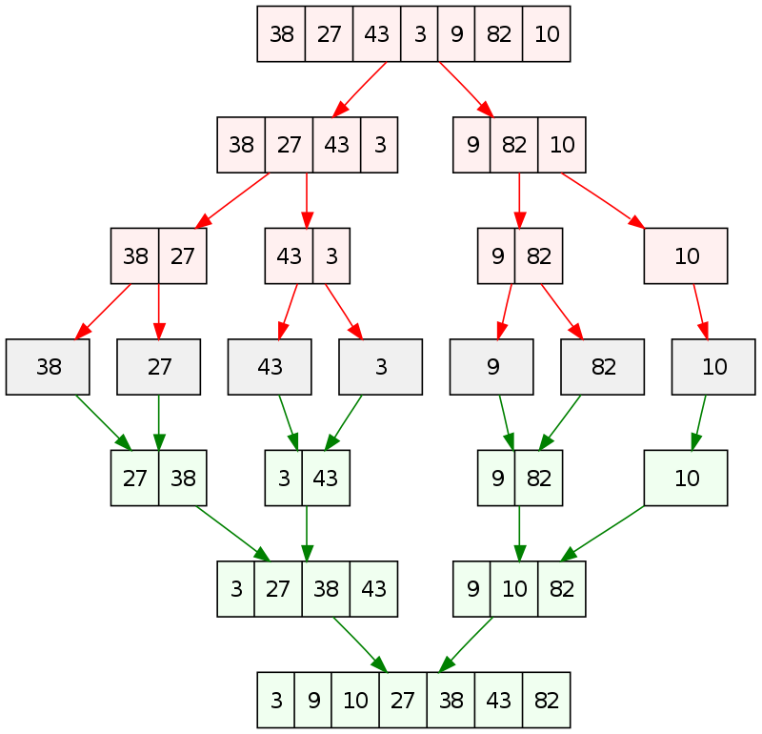
Example
Illustration of Merge Sort
Step 1: Break the unsorted array into multiple small segments until you reach the smallest possible segment size
Step 2: Combine the segments in a sorted fashion
Step 3: Start the recombination process to obtain the final array

Slide 4
Problem Statement
Tower of Hanoi is a mathematical puzzle where we have three rods and n disks. The objective of the puzzle is to move the entire stack to another rod, obeying the following simple rules:
Only one disk can be moved at a time.
Each move consists of taking the upper disk from one of the stacks and placing it on top of another stack i.e. a disk can only be moved if it is the uppermost disk on a stack.
No disk may be placed on top of a smaller disk.
Answer to this is implemented in “Tower_of_Hanoi.py”

